Slide 1

What are we going to see in this session?
Infrastructure Prerequisite
Open AWS account
Create IAM admin user
Account final setup
Create security group

Slide 2
Infrastructure Prerequisite
We just need one AWS account for practise.
One Linux or Windows machines from where you can keep your codes and apply.

Slide 3
Open AWS account
As mentioned earlier we are going to see terraform with AWS in coming sessions. Hence to practice on your own you might need an AWS account.
Most of you all know, AWS provides certain service for free on first year of your subscription so anyone can open new account with AWS and start exploring it. AWS Link
With this free account you can start spinning up some basic configuration VMs [Which is called Free tire EC2 instances] in AWS.
Do note : Things might cost you when you are intend to use AWS free platform.
using any others services such as S3, RDS etc..
Spinning up high resource machines apart from free tire.

Slide 4
Create your IAM admin user
Navigate to IAM in AWS console.
Create an user called terraform [We are going to perform all automation activities through this IAM account from Terraform]
Select create individual IAM users
username = terraform
Enable programmatic access [Because we are going to access this user only through program not for login]
Create new group = terraform-administrator
Provide admin access to created group.
Add user terraform to group terraform-administrator.
Once user is created – You will get [Access key ID & Secret key]
You can also download the keys as CSV file.

Slide 5
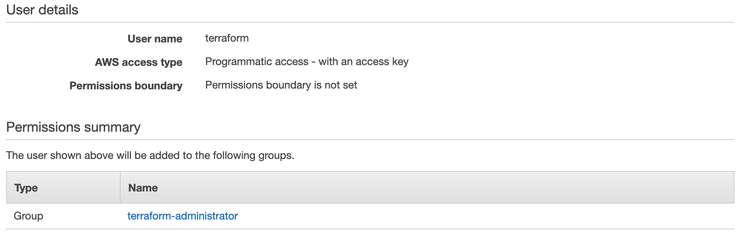
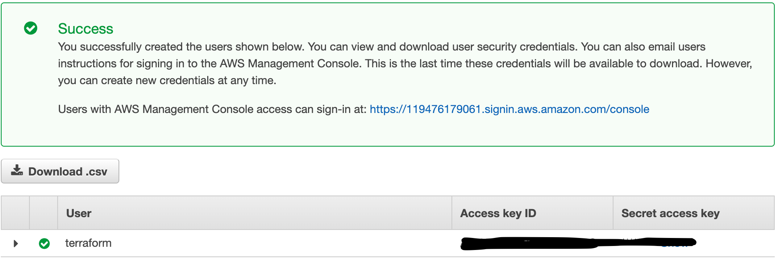
Account final setup
User & Group creation :
Secret access Keys
Excel file :

Slide 6
Create security group
Also you can create your own security group and define the inbound and out bound traffics well in prior.
I have created security group with name [My_custom_SG] which allows SSH (22), ICMP & HTTP (80) connections.
You need to take a note of your security group ID which will be more similar like this sg-0eb17f441ddxxxxxx which you can use in terraform file and ensure all your instances are deployed underneath.

Slide 7
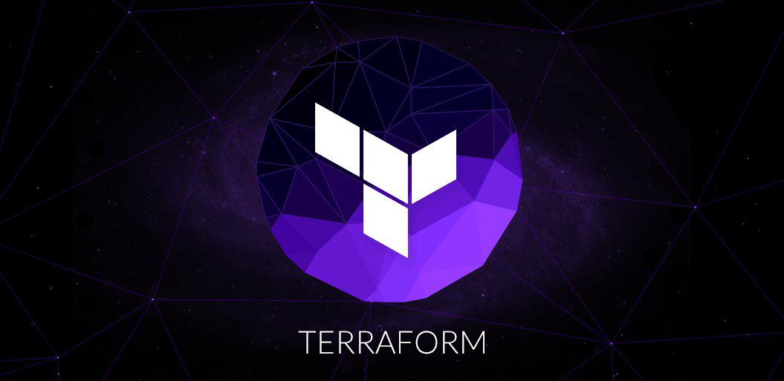
End of this topic !
Any questions?

